Slide 1


SUPPLY CHAIN ANALYSIS
Submitted by - K. Poornima
Project Team ID - PTID-CDA-JUN-26-11134

Slide 2
Project Objective
Objective
The objective of this project is to analyze the company's supply chain data using Power BI to gain meaningful business insights and improve overall supply chain performance.
Project Goals
Analyze sales performance across different product categories.
Monitor inventory levels to identify low-stock and excess-stock products.
Evaluate customer demographics and revenue contribution.
Assess supplier performance based on revenue, lead time, and defect rate.
Analyze shipping and transportation costs to improve logistics efficiency.
Evaluate manufacturing costs, production volume, and lead time.
Analyze product quality using inspection results and defect rates.
Build an interactive Power BI dashboard to support data-driven business decisions.

Slide 3
Dataset overview
Key Attributes
Product Type
SKU (Stock Keeping Unit)
Price
Revenue Generated
Number of Products Sold
Stock Levels
Supplier Name
Customer Demographics
Shipping Carrier & Shipping Cost
Lead Time
Manufacturing Cost
Production Volume
Inspection Results
Defect Rate
Transportation Mode & Route

Slide 4
Data Cleaning & Preparation
Data Source
Connected to the MySQL database provided by Datamites.
Imported the Supply Chain dataset into Power BI.
Data Cleaning
Checked for missing (null) values.
Removed duplicate records.
Verified and corrected data types (Text, Whole Number, Decimal Number).
Renamed columns where required for better readability.

Slide 5
Data Preparation
Created DAX measures for key performance indicators:
  Total Revenue
  Total Products Sold
  Average Price
  Average Lead Time
  Average Shipping Cost
  Average Manufacturing Cost
  Average Defect Rate
Created calculated columns such as:
  Profit
  Profit Margin %
  Stock Status (Low Stock / Excess Stock / Normal Stock)
  Lead Time Category

Slide 6
PROJECT WORKFLOW
Requirement Analysis
Data Collection
Data Cleaning
Data Modeling
DAX Calculations
Dashboard Creation
Data Analysis
Business Recommendation

Slide 7
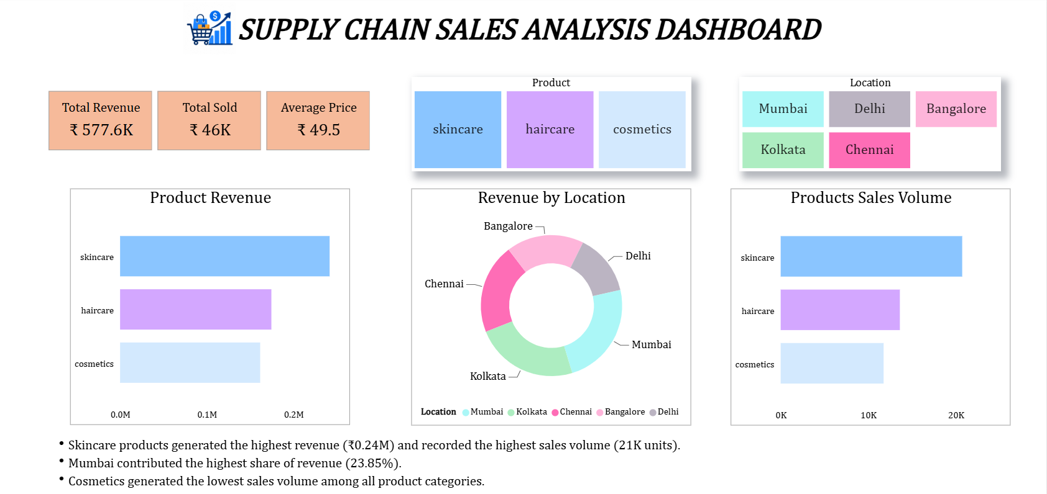
Sales dashboard

Slide 8
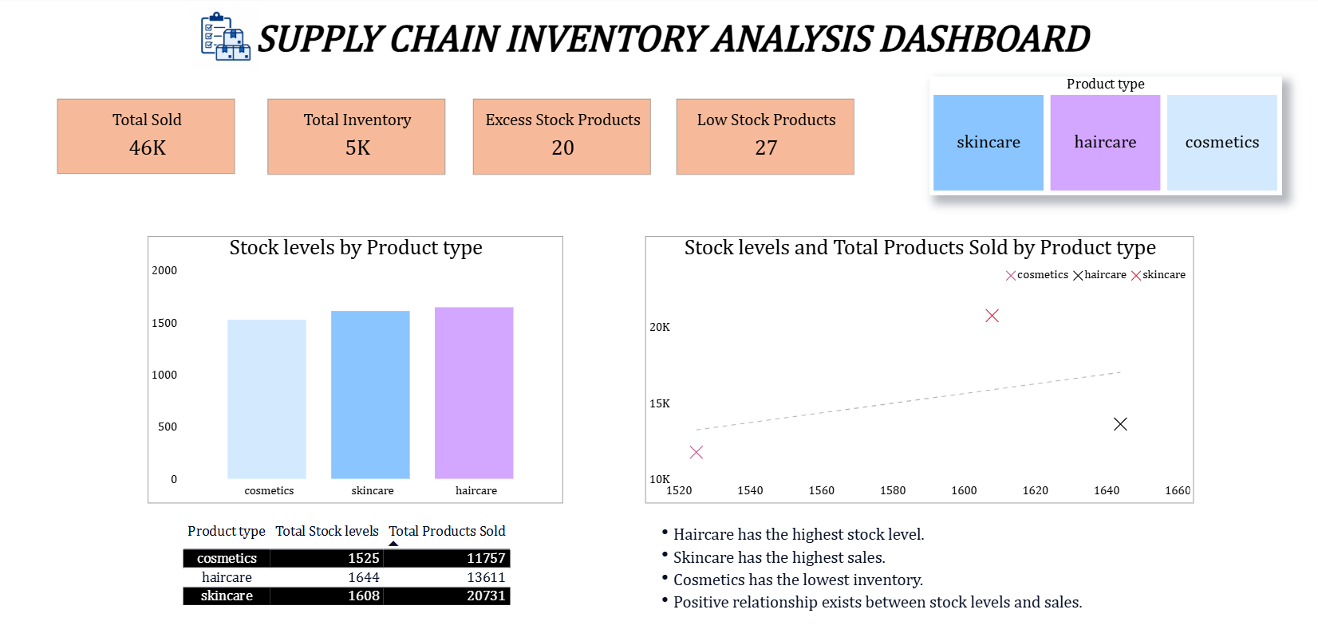
Inventory dashboard

Slide 9
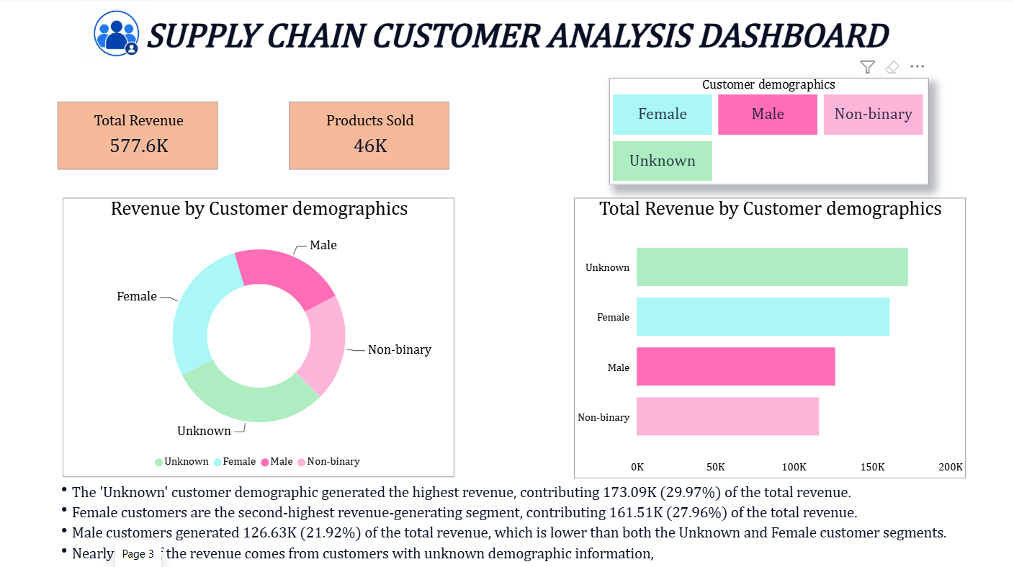
Customer dashboard

Slide 10
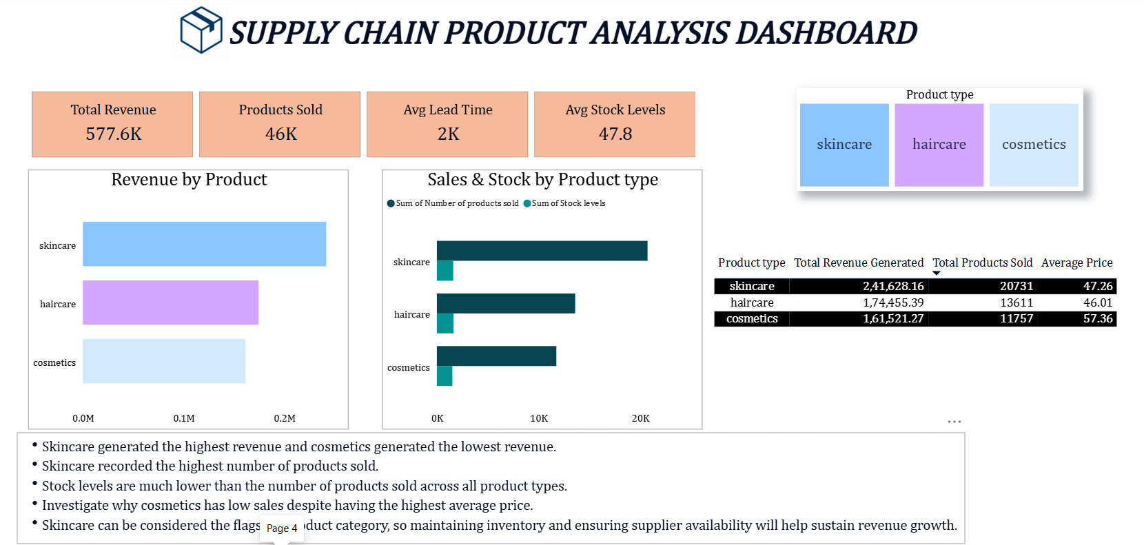
Product dashboard

Slide 11
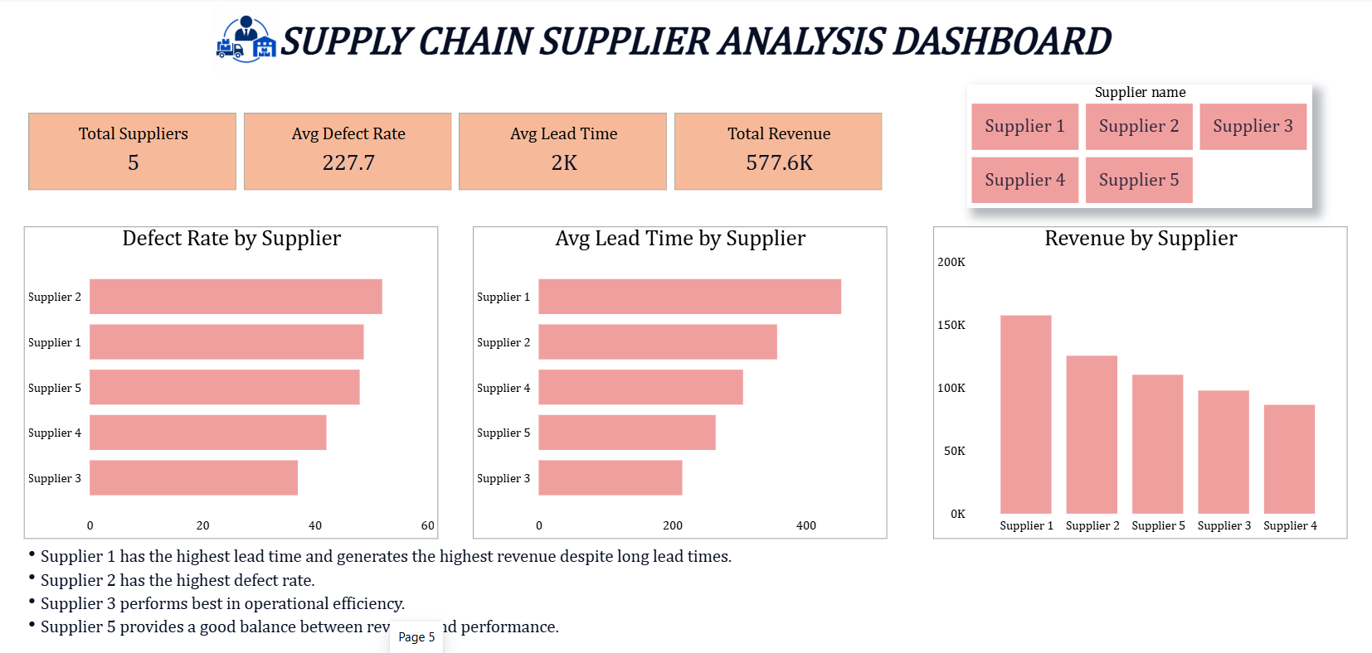
Supplier dashboard

Slide 12
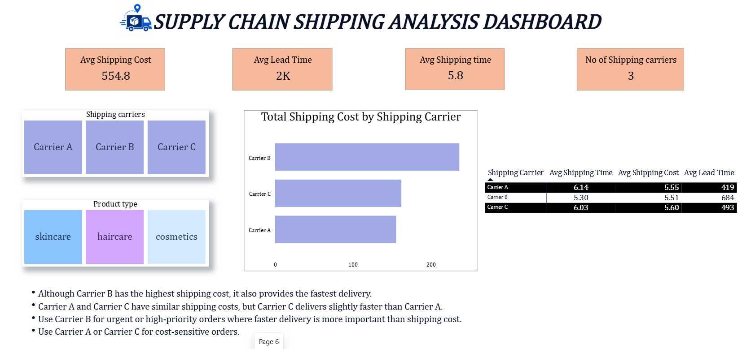
Shipping dashboard

Slide 13
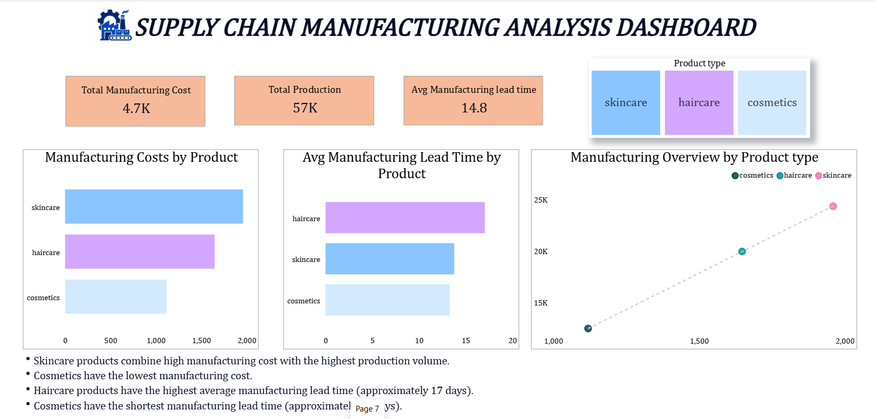
Manufacturing dashboard

Slide 14
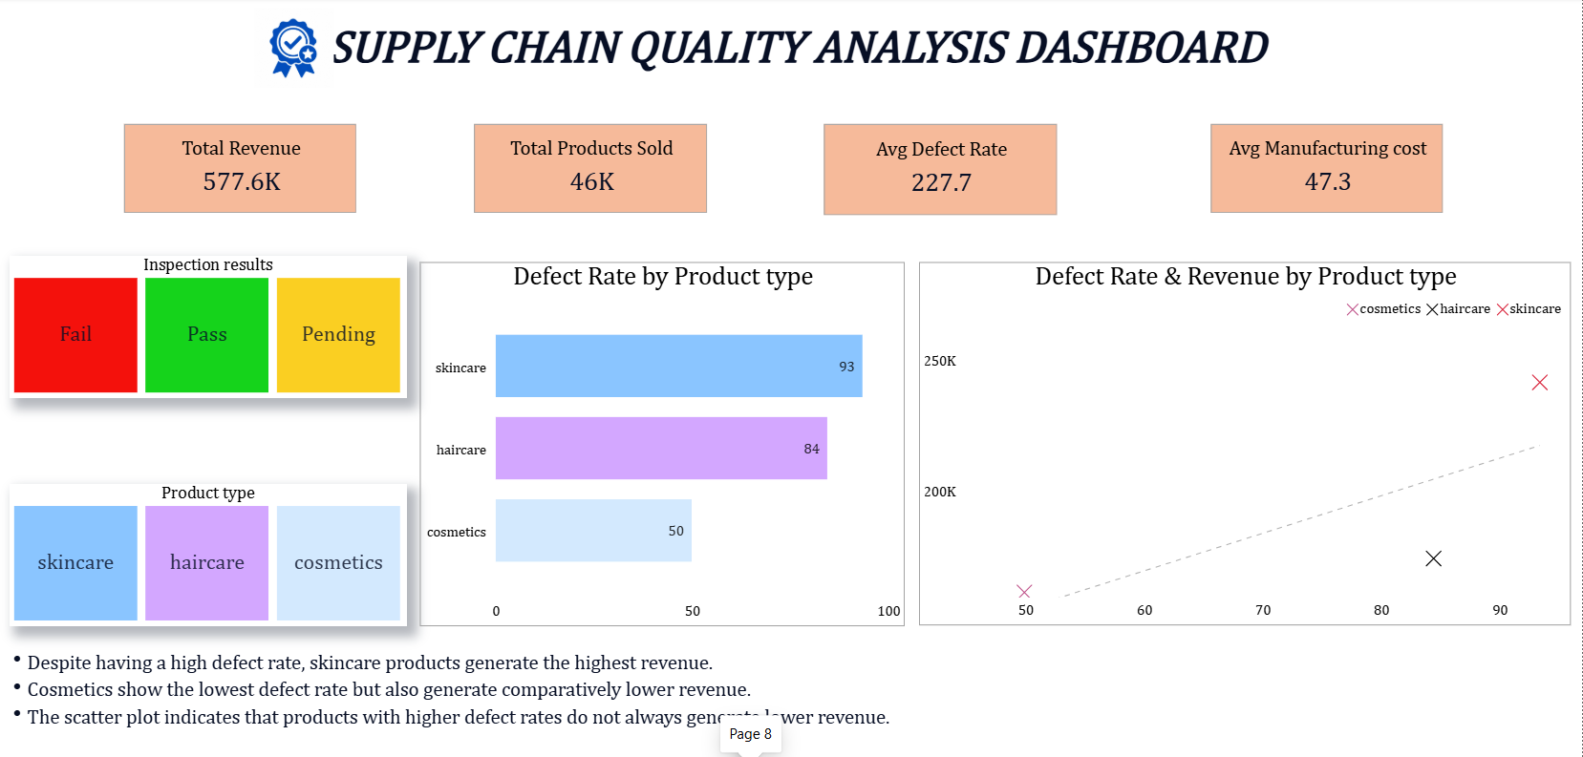
Quality dashboard

Slide 15
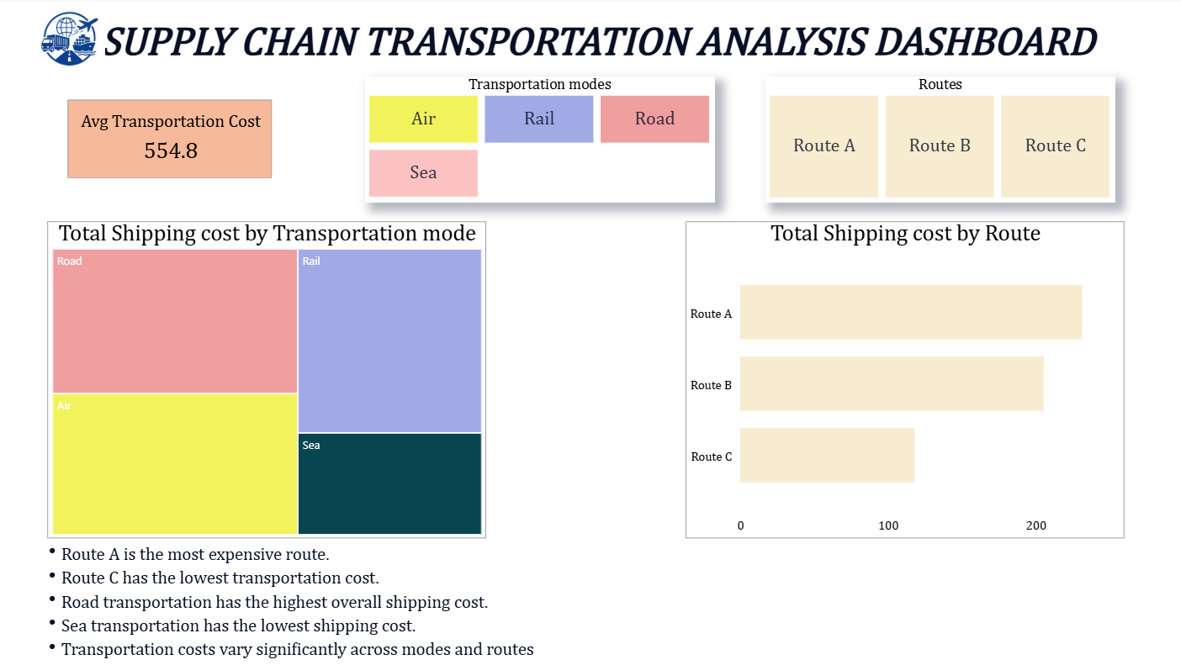
Transportation dashboard

Slide 16
Key insights
Skincare generated the highest revenue.
Mumbai contributed the highest revenue.
Haircare maintained the highest inventory.
Positive relationship exists between inventory and sales.
Unknown customer demographic generated the highest revenue.
Skincare is the best-performing product category.
Cosmetics has the highest average price but lowest sales.
Supplier 1 generates the highest revenue.
Supplier 2 has the highest defect rate.
Supplier 3 performs best overall.
Carrier B provides the fastest delivery.
Carrier B also has the highest shipping cost.
Carrier A and C are better choices for cost-sensitive deliveries.

Slide 17
Skincare has the highest manufacturing cost.
Haircare has the longest manufacturing lead time.
Cosmetics has the lowest manufacturing cost.
Skincare has the highest defect rate.
Despite defects, skincare generates the highest revenue.
Cosmetics has the lowest defect rate.
Route A has the highest transportation cost.
Sea transportation has the lowest shipping cost.
Transportation costs vary across routes.

Slide 18
Business recomendations
1. Increase Inventory for Skincare Products
Skincare products generated the highest revenue and sales.
Maintain sufficient stock levels to avoid stock-outs and meet customer demand.
2. Improve Supplier Performance
Supplier 2 has the highest defect rate, while Supplier 1 has the longest lead time.
Work with these suppliers to improve product quality and reduce delivery delays.
3. Optimize Shipping Strategy
Use Carrier B for urgent deliveries because it provides the fastest shipping.
Use Carrier A or Carrier C for cost-sensitive shipments to reduce logistics expenses.
4. Reduce Manufacturing Lead Time
Haircare products have the highest manufacturing lead time.
Improve production planning and streamline manufacturing processes to reduce delays.
5. Strengthen Quality Control
Skincare products show the highest defect rate despite generating the highest revenue.
Implement stricter quality inspections to reduce defects and improve customer satisfaction

Slide 19
6. Optimize Transportation Costs
Route A has the highest transportation cost.
Review transportation routes and consider alternative routes or transport modes to reduce costs.
7. Focus on High-Performing Products
Continue investing in skincare products through better inventory management and marketing.
Develop strategies to improve sales of cosmetics and haircare products.
8. Improve Customer Data Collection
A large portion of revenue comes from customers with Unknown demographics.
Collect complete customer information to enable better customer segmentation and targeted marketing.

Slide 20
conclusion
"The Power BI dashboard provides a comprehensive overview of the company's supply chain. The analysis highlights opportunities to improve inventory management, supplier performance, product quality, shipping efficiency, and transportation costs, enabling better business decision-making."

